Slide 1
A novel automated method for doing registration and 3D reconstruction from multi-modal RGB/IR image sequences
Richard Kirby and Ross Whitaker
University of Utah

Slide 2
Outline
Conceptual idea
Motivation
Theory
Results
Conclusions
University of Utah
Notes:
High level, what we are trying to accomplish, then the motivation behind our approach. The theory and equations that support the work, results and conclusions.

Slide 3
Outline
Conceptual idea
Motivation
Theory
Results
Conclusions
University of Utah

Slide 4
Conceptual Idea - 3D Reconstruction using optical flow field alignment
Registration
and
3D Reconstruction
Camera 1
View 1
Wavelength 1
Camera 2
View 2
Wavelength 2
I1_RGB
I1_IR
RGB Flow
IR Flow
I0_RGB
I0_IR
University of Utah
Notes:
Start with a sequence of images from two cameras that image the scene from two different views. In the work that we are reporting here, the camera rig is a traditional binocular stereo and the two wavelengths (or wave length ranges) are visible light (RGB) and NIR.
Acquire the synchronized images.
Compute the flow fields
Align the flow fields using a variational methods.
Once the flow fields are aligned we can directly compute an estimate of both the dense depth map and the 3D motion field.

Slide 5
Outline
Conceptual idea
Motivation
Theory
Results
Conclusions
University of Utah

Slide 6
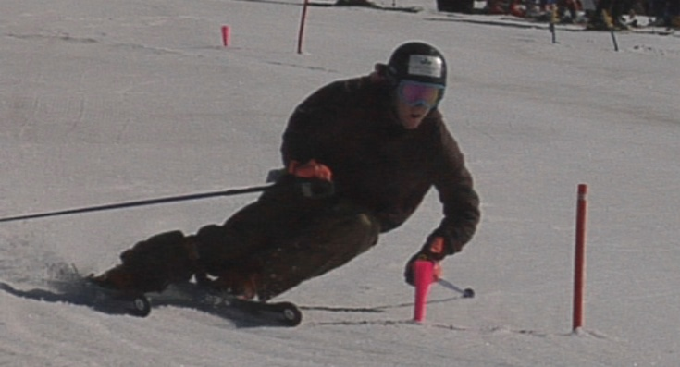
Original Motivation
University of Utah

Slide 7
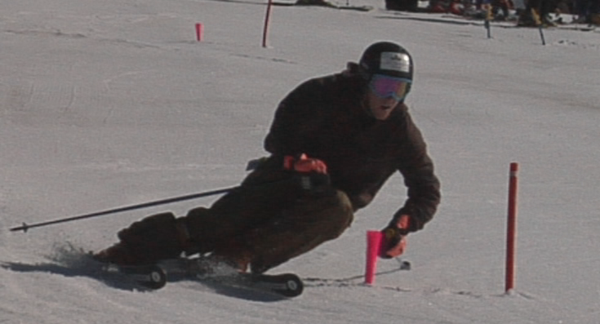
Original Motivation
University of Utah
Notes:
Trying to do motion analysis of work cup skiers. Normally you’d just put motion capture markers on the skier, but that is extremely difficult in sunlight on snow and over the distances that skiers perform.

Slide 8
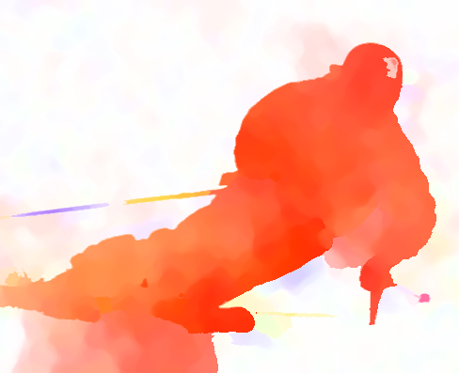
Original Motivation
University of Utah
Notes:
This uses the Daniel Sharstein scheme that uses color to indicate direction and saturation to indicate magnitude

Slide 9
Can 3D depth/velocity maps be estimated directly from flow fields?
Bypass pixel/feature stereo correspondence finding.
Simultaneous dense depth map and dense 3D motion field.
Faster than finding stereo?
Side benefit: flow fields are largely invariant to the wavelength being imaged, implies that reconstruction is possible from different wavelength images.
University of Utah

Slide 10
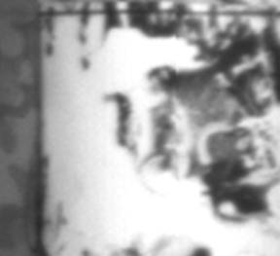
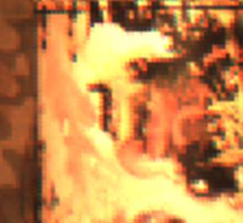
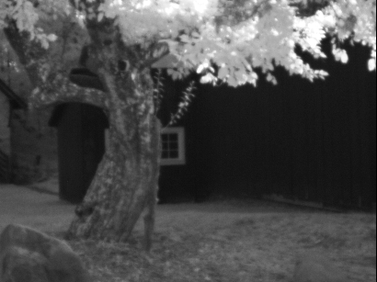
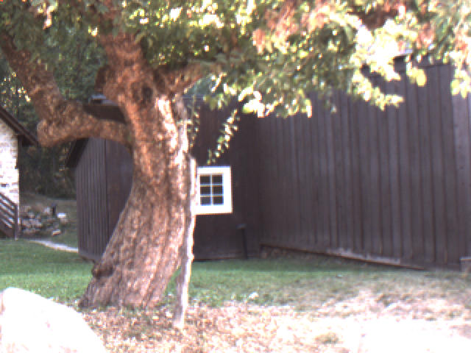
Applications
3D motion field camera rig
Multi-modal camera rig
If optical flow is invariant to the wavelength of light being imaged: Intra-camera pixel/feature correspondences are not required for image registration and 3D reconstruction.
Notes:
We are not finding intra camera correspondences.
Normal pixel/feature detectors have significant problems even with RGB/NIR image pairs.

Slide 11
Outline
Conceptual idea
Motivation
Theory
Results
Conclusions
University of Utah
Notes:
Is there enough information to align optical flow fields taken from two different views?

Slide 12
Assumptions
Scene is smoothly deformable.
There must be relative movement between the camera rig and the scene.
Optical flow need not be an accurate projection of the 3D motion field, but errors in optical flow computation should be consistent with projection equations.
Scene must have enough visual texture to generate optical flow.
University of Utah
Notes:
Optical flow need not be an accurate projection of the 3D motion field for the depth map.

Slide 13
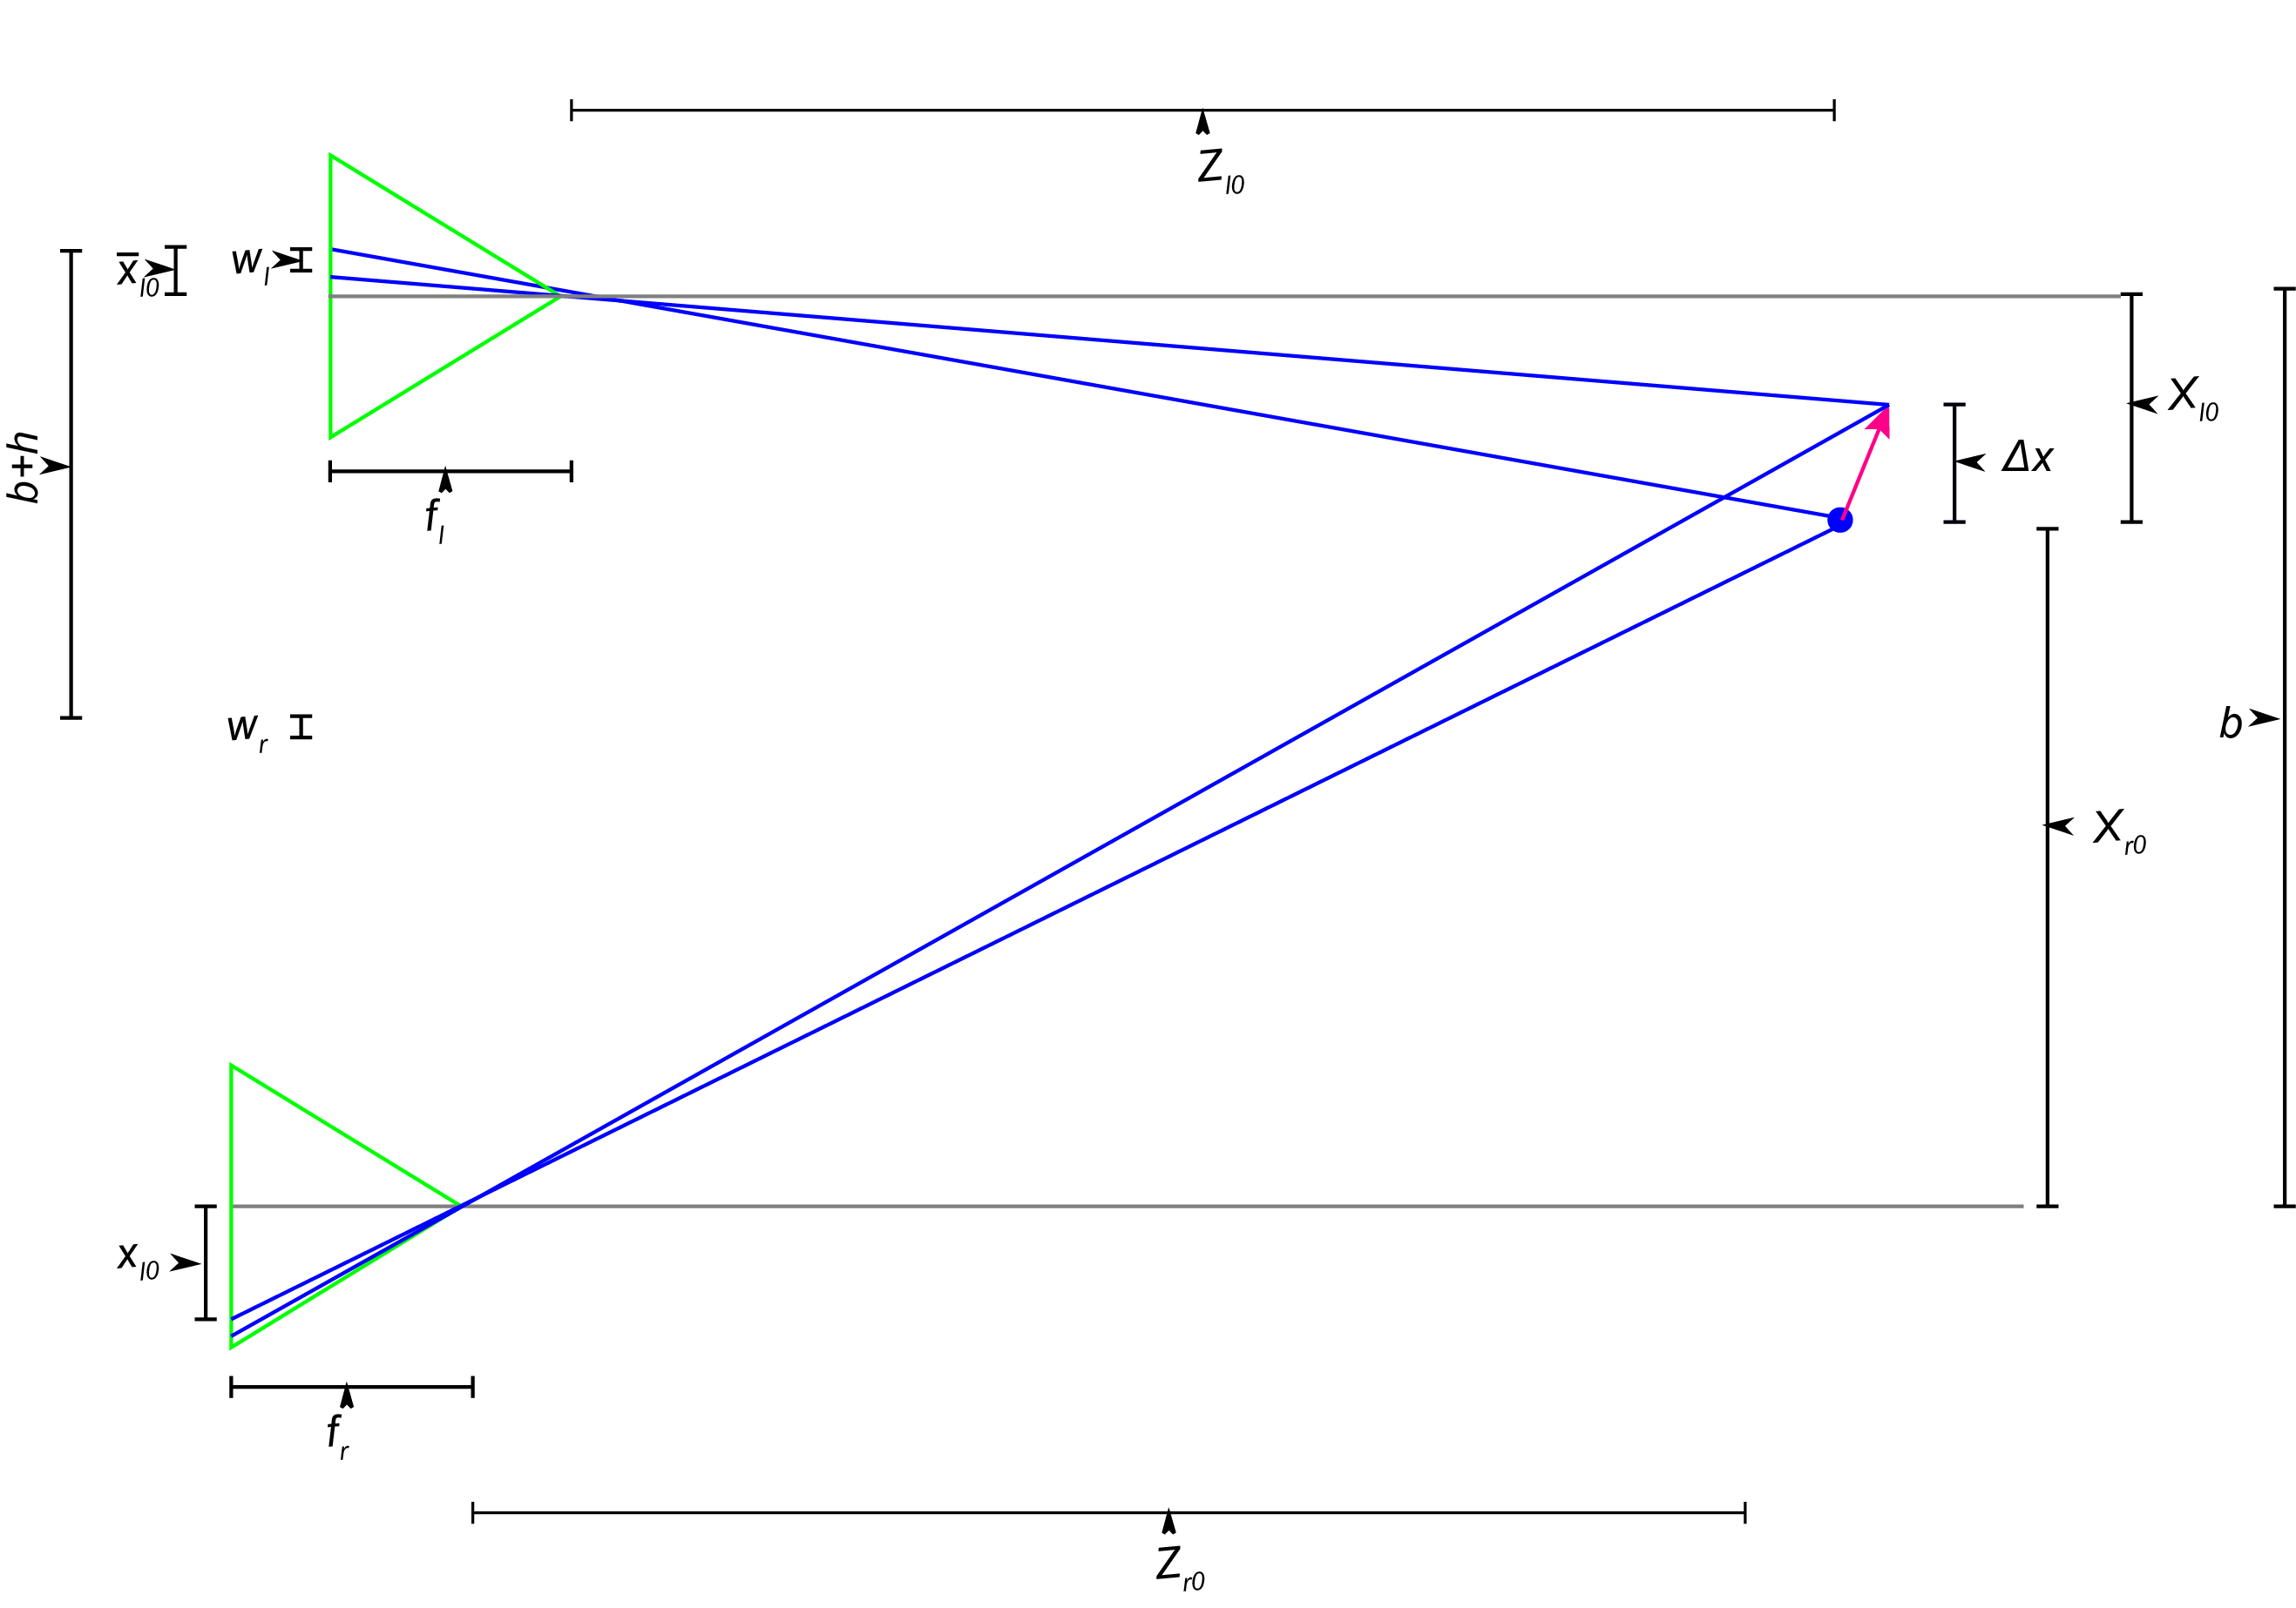
Camera Geometry
Note: Cameras must of different focal lengths.
Notes:
Standard pin-hole camera model and binocular stereo.

Slide 14
Why different focal lengths?
Different focal lengths required to match frontal planar surfaces otherwise energy is the same for all points along a frontal planar surface
Addition advantage: energy response is substantially more acute.
Complications
Epipolar line in one camera is not a horizontal line in the other camera
Notes:
Flow variability in this method is similar to pixel intensity variability. However, we can get around this with optical flow by using different focal length lenses. Think of the entire scene being frontal planar, any point would match any point.

Slide 15
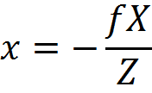
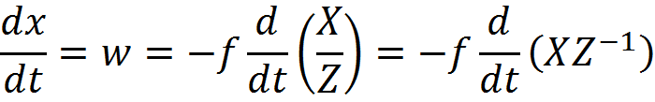
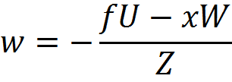
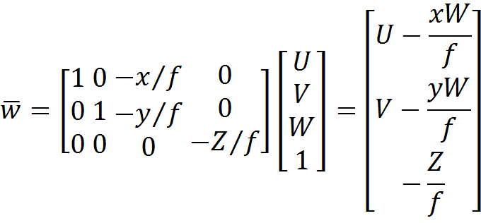
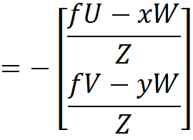
Energy derivation – Optical Flow
This represents four
equations with four
unknowns U, V, W,
and Z.
University of Utah
Notes:
One camera only for clarity. Using the product rule and chain rule.

Slide 16
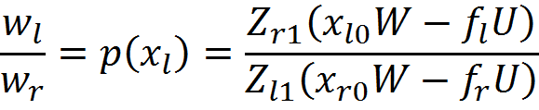
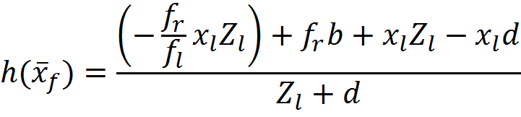
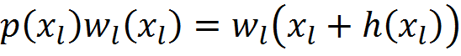
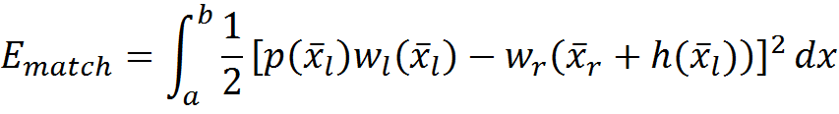
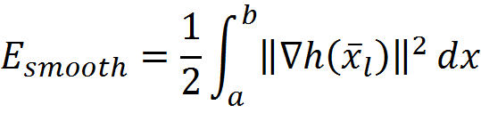
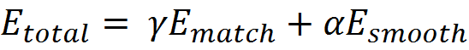
Energy functional - Relationship between flow in two cameras
Regularization/smoothness term: penalty for
discontinuities.
Notes:
Fairly naïve approach, no gradient term, nothing for large displacements. We can get away with this because optical flow is relatively smooth, but we may be able to make some improvements playing with scale and gradient.

Slide 17
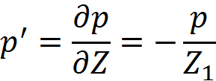
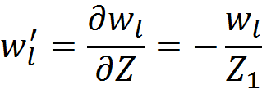
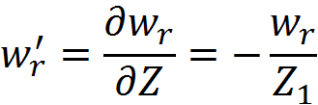
Numerical Solution Euler-Lagrange
Solve using standard gradient decent algorithm.
University of Utah

Slide 18
Outline
Conceptual idea
Motivation
Theory
Results
Conclusions
University of Utah

Slide 19
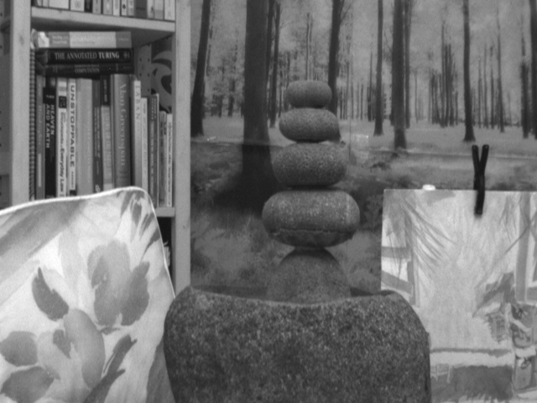
University of Utah
Notes:
Left camera NIR, about 900 nm

Slide 20
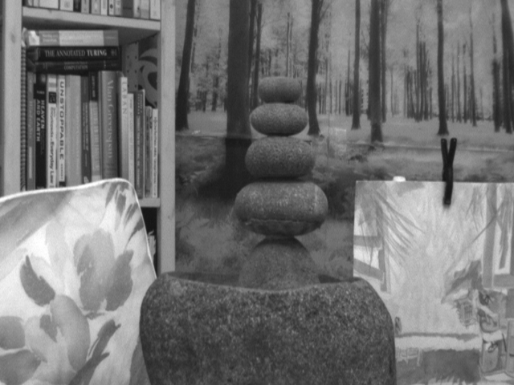
University of Utah

Slide 21

University of Utah
Notes:
The optical flow, some anomolies and some loss of fine detail.

Slide 22
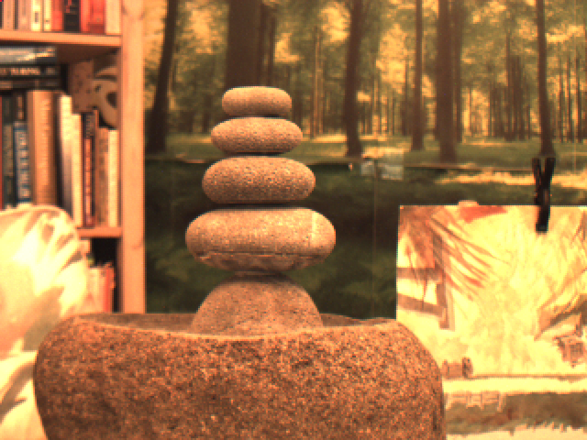
University of Utah
Notes:
Right camera RGB

Slide 23
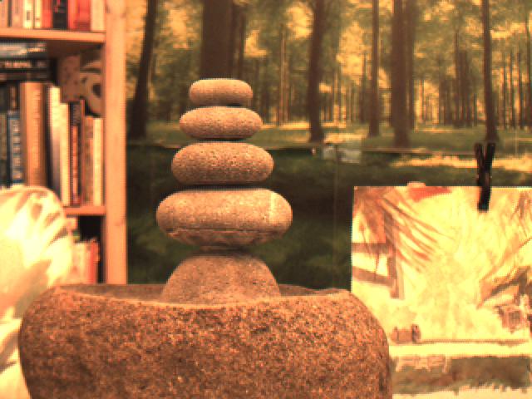
University of Utah

Slide 24

University of Utah
Notes:
Again some anomalies and loss of fine details. Particularly the filled in spot between the fountain and the water color.

Slide 25
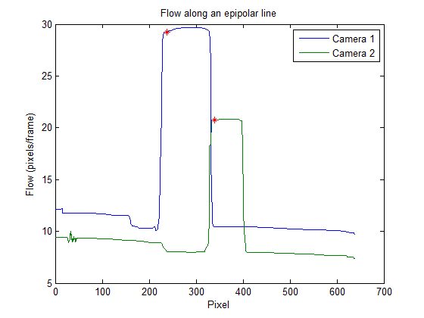
University of Utah
Notes:
Three different points, this first one is front edge of a discontinuity. Notice that the optical flow from the front and back camera made the same error in the filled in position. The left camera is our reference camera.

Slide 26
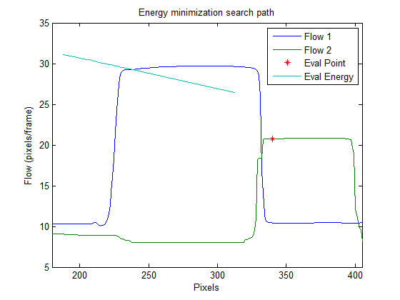
University of Utah
Notes:
This is the path followed by the gradient descent coming from above or below. The slope of the line is dependant on the ratio of the focal lengths, so you can see if the cameras had the same focal length the gradient descent would follow a horizontal line. A horizontal line would fail on frontal planar surfaces.

Slide 27
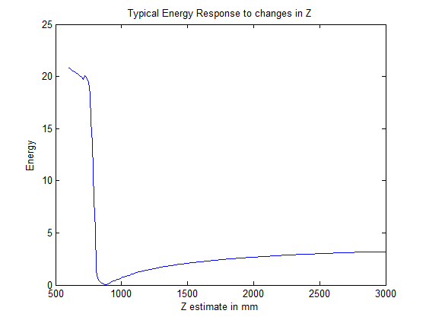
University of Utah
Notes:
Energy response. Steep when coming from below because of edge and relatively flat when coming from above because of the frontal planar surface, but the results is still a distinct energy minimization. If the cameras had the same focal length the right line would be horizontal and there wouldn’t be a single point where the energy is minimal.

Slide 28
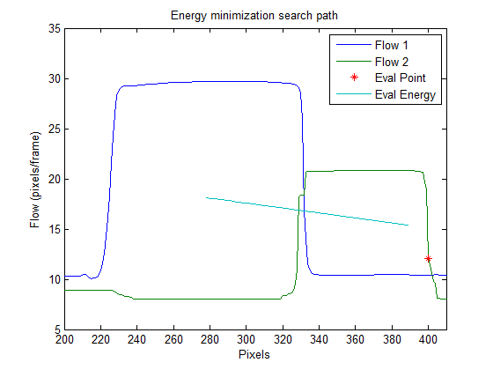
University of Utah

Slide 29
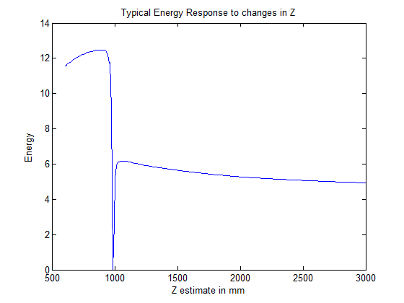
University of Utah

Slide 30
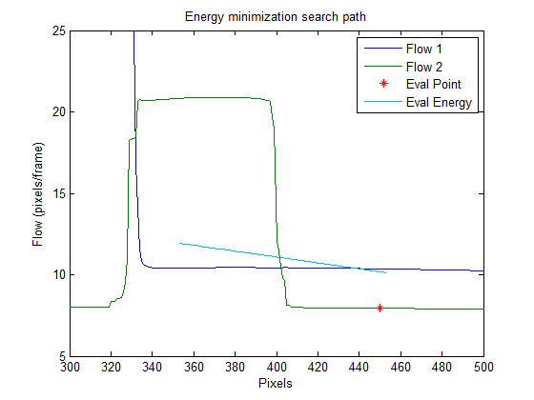
University of Utah

Slide 31
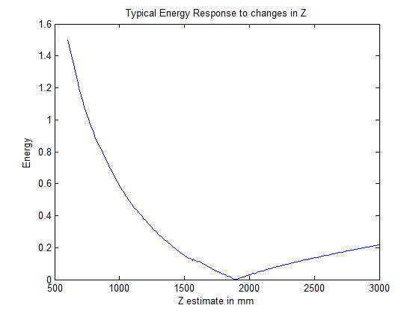
University of Utah

Slide 32
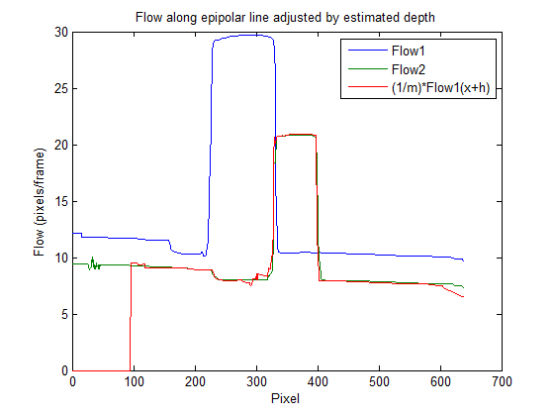
RMS error = 0.086 pixels
University of Utah
Notes:
Normally you’d lose both edges, but the left camera has a wide enough angle lens that we only lose one side of the higher focal length image.

Slide 33
University of Utah

Slide 34
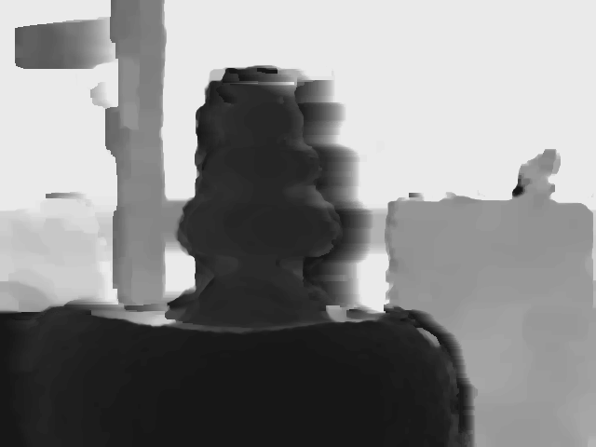
University of Utah
Notes:
This a 3D reconstruciton without any intra camera pixel or feature correspondence finding using an IR and an RGB camera.

Slide 35
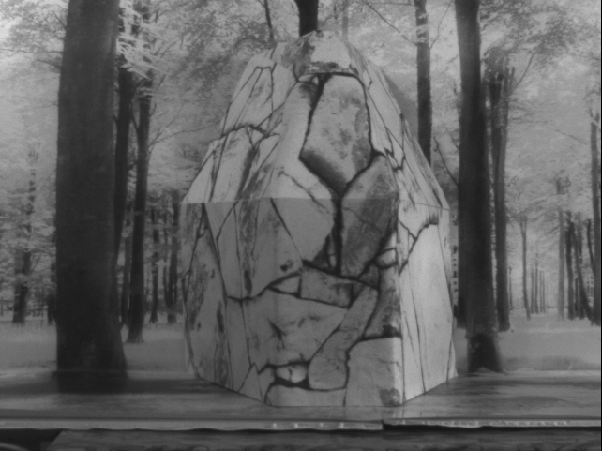
University of Utah

Slide 36
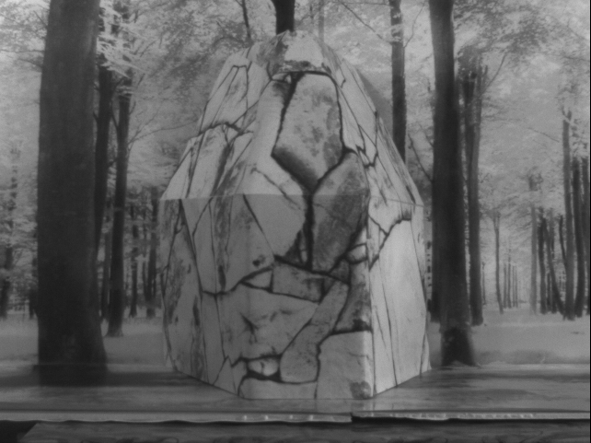
University of Utah

Slide 37
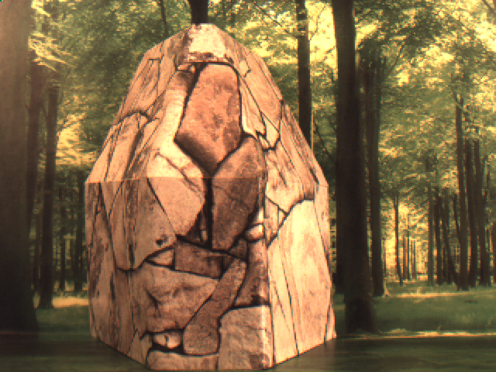
University of Utah

Slide 38
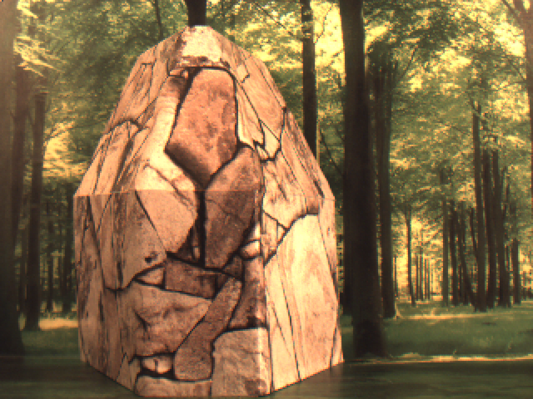
University of Utah

Slide 39
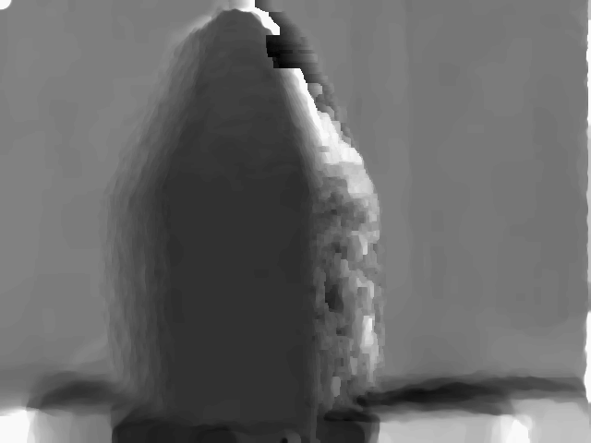
University of Utah

Slide 40
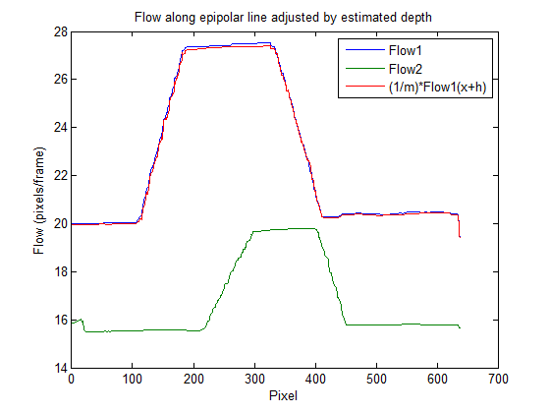
University of Utah

Slide 41
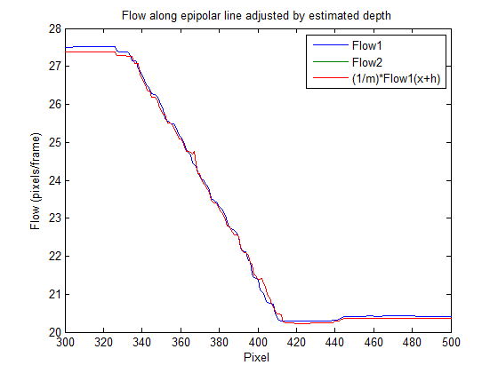
University of Utah

Slide 42
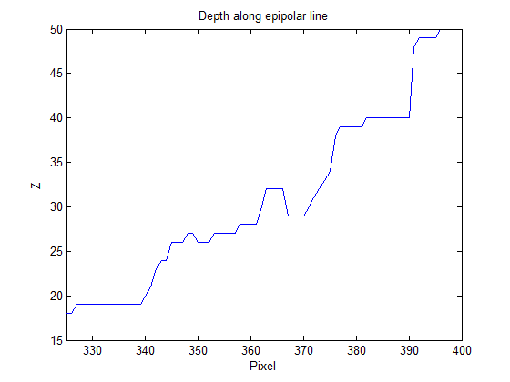
~+/- 2% depth error
University of Utah

Slide 43
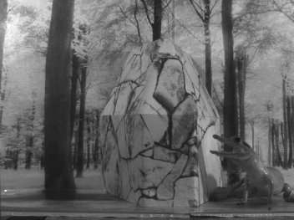
University of Utah

Slide 44
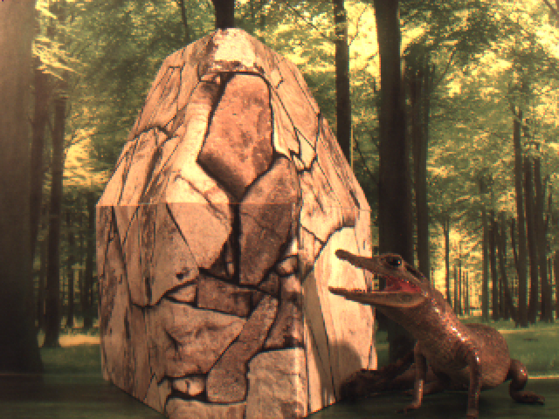
University of Utah

Slide 45
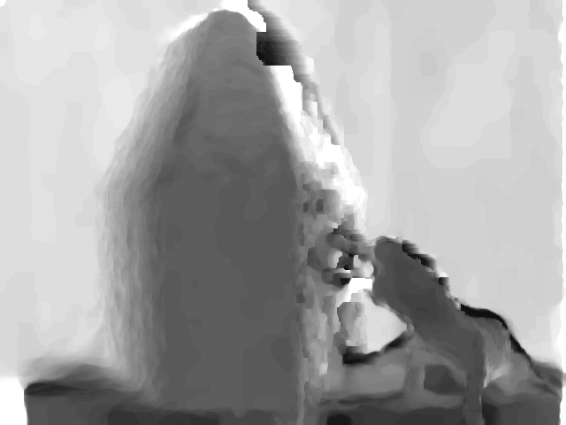
University of Utah
Notes:
2-90-4-3. This is done entirely with optical flow, no intra image correspondences with a relatively naïve energy equation a single matching term and a non-robust regularization term.

Slide 46
Conclusions
Optical flow fields obtained from different wavelength images can be aligned using a variational methods energy minimization methodology.
3D reconstruction is nearly as good as the optical flow it is derived from (better than 1/10 pixel RMS errors).
Produces dense depth map without using intra-camera pixel/feature correspondences.
University of Utah
Notes:
Second point suggests that as optical flow improves this technique will get better as well.

Slide 47
Thank you and Questions
University of Utah

